Slide 1

Numbers on the Crisis
KURABOT
Companies
Employees
GDP
> 100K
> 20%
- 4%
More than 100’000 companies are directly affected by the crisis
More than 20 % of the employees are working in a directly affected company
Experts expect a decline in the Swiss GDP up to 4.0 %

Slide 2


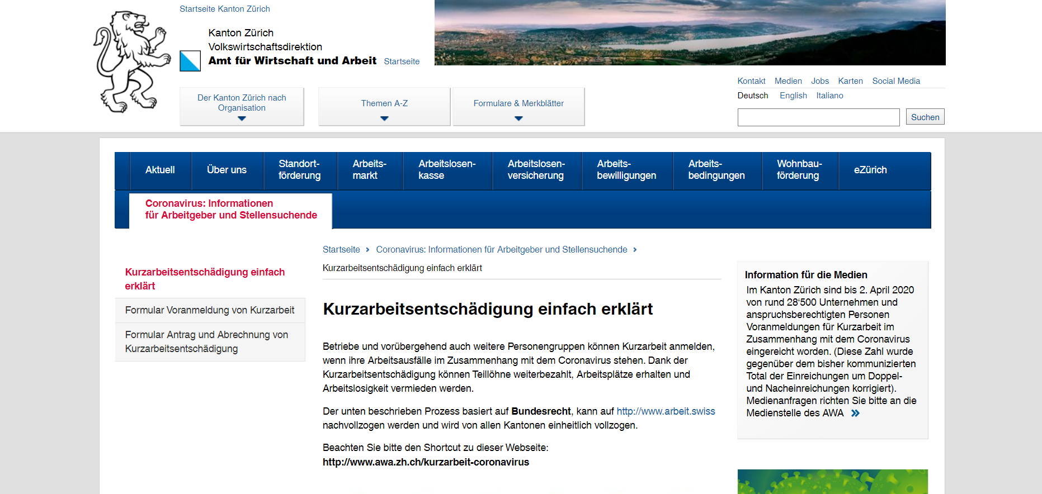

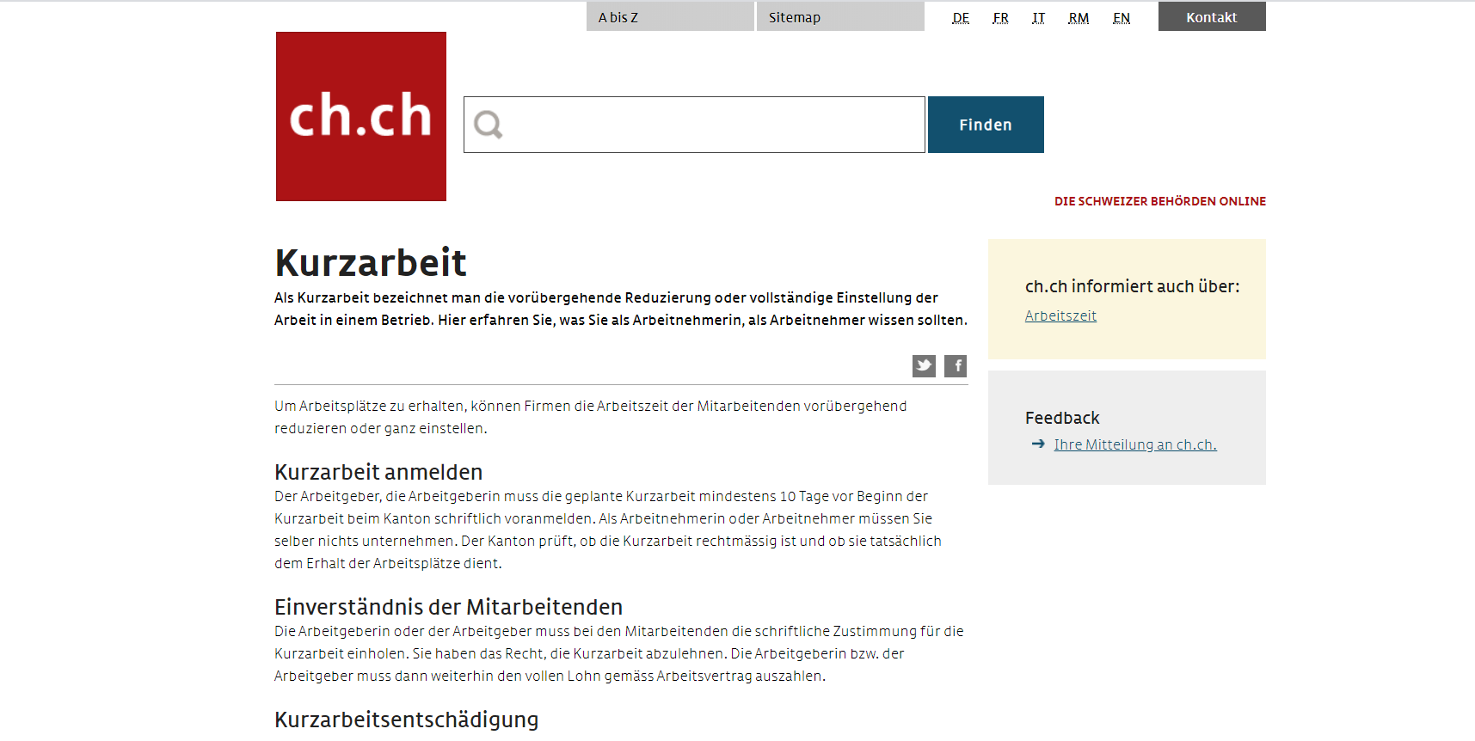
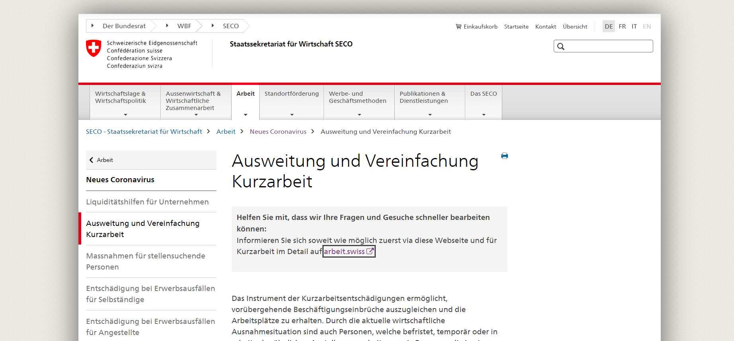
How to apply for “Kurzarbeit“
KURABOT
KURABOT
www.chatbot.com

Slide 3
Kurzarbeit Chat Bot (KURABOT)
KURABOT
KURABOT: Wie kann ich Ihnen weiterhelfen?
Employer: Wie kann ich Kurzarbeit beantragen?
KURABOT:
Holen Sie zuerst das Einverständnis aller von Kurzarbeit betroffenen Mitarbeitenden mit der Einführung von Kurzarbeit ein ...
Füllen Sie das Formular «Voranmeldung von Kurzarbeit» aus und …
KURABOT
www.chatbot.com

Slide 4



Value Proposition
KURABOT
For authorities
For employers
For employees
Increased consultancy quality
Less congestion
Fast access to information
Less insolvencies
Faster payment settlement
Less layoffs

Slide 5
Implementation Roadmap
KURABOT
Collect requirements on Q&A’s from public authorities
Translate information and national rollout in Switzerland
Start
End
01
02
03
04
Complete web app and integrate into national website
Add further Corona-related features to web app and chatbot

Slide 6

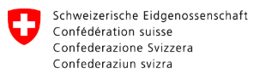







Behind the Scenes
KURABOT
Chatbot
Web App
Integration
Effortlessly scalable cloud solution
Customizable QnA
Corona newsticker
Live corona dashboard
Seamless integration into websites, Skype, Facebook and more

Slide 7

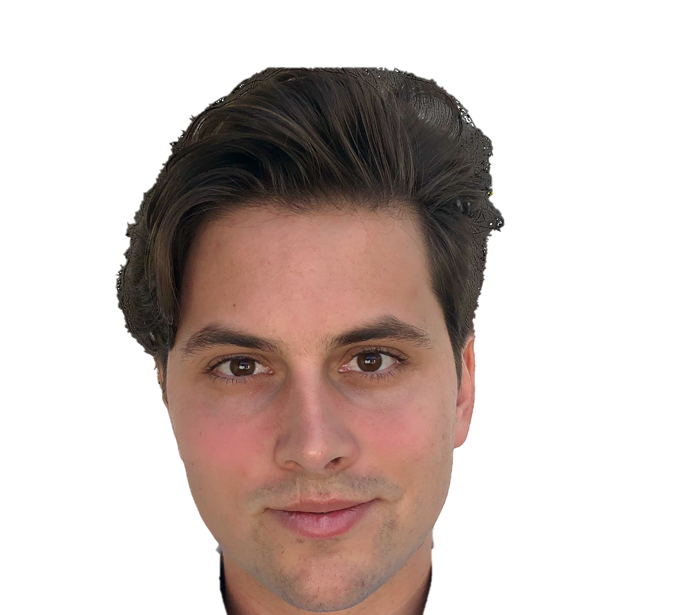



The Corona Fighters
KURABOT
Nurses
Cashiers
Doctors
Officials
and much more!
David
Stammbach
Jürg
Käser
Minh-Kha
Nguyen
Torben
Mannhart
2m
Web App
Chatbot
Business
Chatbot

